Slide 1
The First Lecture
Dr. Edward J. Brash
Christopher Newport University

Slide 2

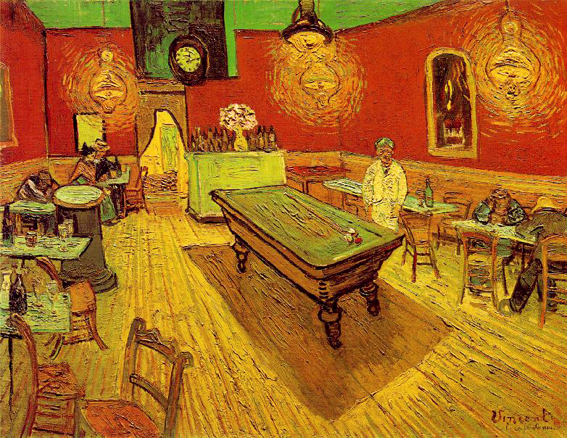

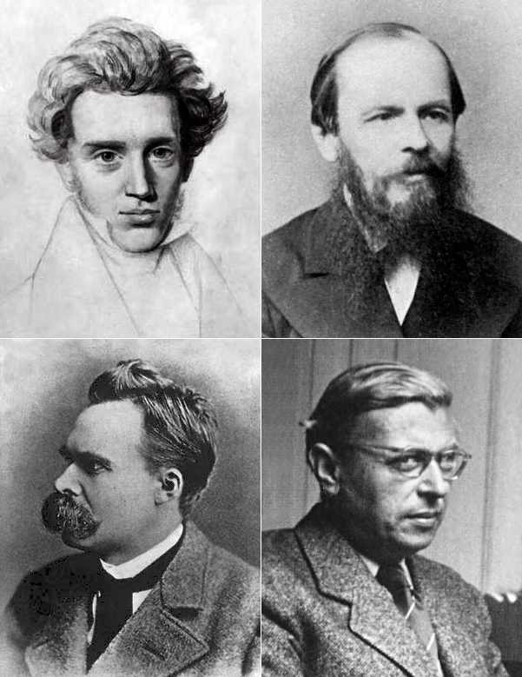

Existentialism
Our starting point as individuals is a sense of disorientation and confusion in the face of an apparently meaningless world.
The individual, not society or religion, is solely responsible for giving meaning to life, and living it passionately and sincerely.
For many physicists, understanding the inner workings of the universe gives meaning to their lives – it truly is their passion!

Slide 3

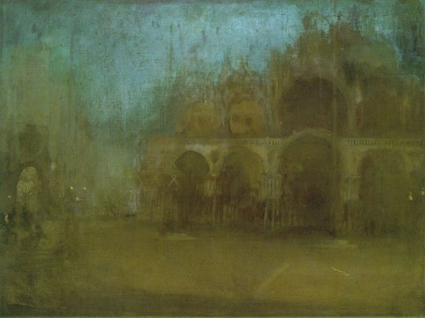
Differing Points of View
St. Mark’s, Venice
Photo-realism vs. Impressionism [Whistler]

Slide 4


Differing Points of View
Main Path through the Garden at Giverny
Photo-realism vs. Impressionism [Monet]

Slide 5
Impression of Reality
“I do what I can to convey what I feel before nature to pin down my sensations.” – Claude Monet (1912)
“More than any other man, Whistler has helped purge art of the vice of subject and belief that the mission of the artist is to copy nature.” – George Moore

Slide 6
Perception of Reality
Theories
Physical Models
Reality
SCIENCE!!!!!!!!!
Mirrors
Distortions
Emotions
Beliefs
Mythologies
Data
Appearance of Reality

Slide 7
What is physics?
Φύσις
Ancient Greek – “physis” … meaning nature
Webster:
Natural scenery
The external world in its entirety
The inherent character or basic constitution of a person or thing
The general analysis of nature, in order to understand how the universe behaves.

Slide 8
Natural vs. Supernatural
“Natural things are things we can see, touch, understand and frequently manipulate. Nature, by definition, is the material world and its phenomena. Supernatural things encompass all things outside the natural world. Since supernatural things evidently have spiritual characteristics, it is not likely we can learn much about spiritual truth by studying and evaluating natural activity.”
– Pastor James Norman

Slide 9
Occam’s Razor
The Law of Succinctness
Among competing theories, the one with the fewest assumptions should be selected
Example 1: New Earth Creationism
In order to reconcile the wealth of experimental data that we have available to us with a model that includes as its basic premise that the earth is 6000 years old, supernatural “corrections” are needed.
Example 2: Planetary Motion
It is possible to describe the other planets in our solar system as revolving around the earth, but that explanation is unnecessarily complex compared to the contemporary consensus that all planets revolve around the sun.

Slide 10
The Modern Scientific Method
Empiricism – experience and evidence, rather than innate ideas and traditions
Theories must be tested against observations of the natural world (experiments).
Viable theories have PREDICTIVE power – this is a very important concept!!!

Slide 11
Theories of the Universe

Slide 12
How to create a Universe (abridged)
(i) create a space for it
(ii) put stuff in it
(iii) let it heat up
(iv) let it evolve
LENGTH – metres, feet, miles, furlongs
MASS – kilograms, pounds, stones
TEMPERATURE – Fahrenheit, Celsius, Kelvin
TIME – seconds, minutes, hours, eons

Slide 13
Measuring things …
We want to collect data about the universe … what kind of data can we collect?
Masses of things (kg)
How far things move (m)
How hot things are (K)
How fast things move (m/s)
How dense things are (kg/m³)
How much energy something has … whoa … wait a minute … what’s energy?

Slide 14
Energy
A very ephemeral concept … not easy to define … we need a definition:
Imagine an object moving with some speed.
Now, imagine that object smashing into a stationary object.
The faster the first object is moving, and the heavier it is, the more ability is has to “move” the second object.
Energy, to a physicist, is the measure of the ability to make an object move through some distance … we call this WORK.
We do work by applying a FORCE to an object and making it move through a DISTANCE.
In the example above, we call this type of energy KINETIC ENERGY … energy of motion.

Slide 15
Forms of Energy
Kinetic Energy … motion
Gravitational Energy … how much work gravity can do
Thermal Energy … how much work we could do by using the heat contained in an object … associated with vibrational motion of electrons around the atom, and in molecules.
Atomic Energy … the energy associated with electrons moving around the nucleus of the atom
Nuclear Energy … the energy associated with the binding of protons and neutrons together in the nucleus
Almost everything that goes on in the universe has to do with converting one form of energy to another!!!

Slide 16
Big Bang Theory
No, not the TV show!
The version of creating a universe that we described before was really not too far off from what we think happened!
In the beginning … there was nothing … no space, no time, no particles, nothing!!!!

Slide 17
Big Bang Theory
The Big Bang is not an explosion in space; it is the rapid expansion of space itself from an extremely hot, dense initial state. At the earliest times:
Temperatures exceed 10^32 K
Energy densities are so high that all known forces may have been unified
Quantum effects of gravity are expected to dominate
This era is called the Planck epoch. Our current theories (general relativity + quantum field theory) cannot reliably describe physics here. Any statements about this regime are extrapolations or belong to candidate theories of quantum gravity.

Slide 18
Big Bang Theory
Shortly after the Planck epoch, the universe likely underwent cosmic inflation:
Space expanded exponentially, growing by a factor of at least 10^{26} in a tiny fraction of a second
Inflation explains several otherwise puzzling observations:
Horizon problem – everywhere we look, the universe looks the same
Flatness problem – the universe is geometrically very close to “flat”
Origin of structure – tiny quantum fluctuations stretched to cosmic scales
These quantum fluctuations become the seeds of all later structure: galaxies, clusters, and the anisotropies seen in the CMB (more later!)

Slide 19
Big Bang Theory
When inflation ends, the energy stored in the inflaton field is converted into particles and radiation — a process called reheating.
The universe now contains: Quarks, Leptons, Gauge bosons, Photons, possibly dark matter particles
Temperatures remain enormous, and particles are constantly created and annihilated in equilibrium.
This marks the beginning of the hot Big Bang phase that is very well described by known physics.

Slide 20
Big Bang Theory
As the universe expands and cools:
Forces that were unified at high energy separate
Particle masses emerge via mechanisms like the Higgs field
Approximate milestones:
Strong force separates first
Electroweak force splits into electromagnetic and weak forces
Fundamental particle identities become well-defined
The universe transitions from a featureless plasma into a system governed by familiar particle physics.

Slide 21
Big Bang and CMB (And God said … let there be light)
When the universe cools to ~3000 K:
Electrons combine with protons to form neutral hydrogen
Scattering drops dramatically
Photons suddenly travel freely
This moment is called:
Recombination (formation of neutral atoms)
Those photons are still traveling today, stretched by cosmic expansion into microwave wavelengths.
🎯 This radiation is the Cosmic Microwave Background (CMB):
Nearly uniform temperature: 2.725 K
Tiny fluctuations at the level of 10^{-5}
Encodes information about the universe’s geometry, contents, and initial conditions

Slide 22
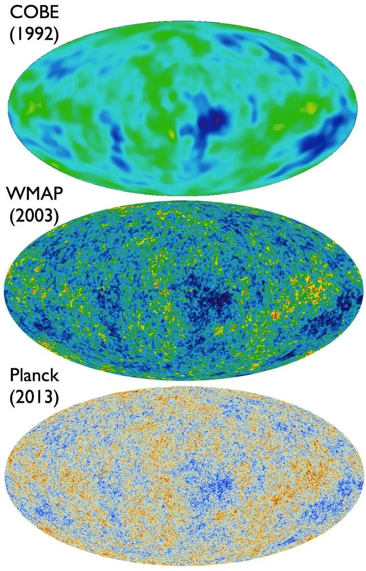

Slide 23
Light
There has been a LOT of debate about this over the centuries!!!!
We know that it is PURE energy (i.e. it has no mass).
We also know that visible light is just one “flavor” of this type of energy, which we call electromagnetic energy
Radio, television, x-rays, UV rays, infrared, microwaves are all flavors of EM energy
How did all these get created, when we only started out with matter and kinetic energy?

Slide 24
Mass energy
So, there was this guy named Albert Einstein …
He said that it was possible to convert mass into pure (EM) energy, and vice versa … pretty cool idea!
He also wrote down this equation that tells us how much energy we can get out of a particular amount of mass
So, is that where all the light came from? Uhmmm … no.

Slide 25
Binding Energy
When things are assembled together nicely, they have LESS energy than when they are separated. This energy difference is called binding energy
In other words, to tear apart a hydrogen atom (a proton and an electron), you have to put energy in to do it … that makes sense.
Conversely, when you let an electron and a proton come together and FORM a hydrogen atom, you get some energy out … how much, I wonder?
Well, it is a really tiny amount … imagine a Big Mac. Now, imagine a sesame seed on the bun of a Big Mac. Now, imagine dividing the sesame seed a trillion times. Then, take one of those pieces, and divide that a trillion times. Think about the number of calories in one of those pieces … that’s what we’re talking about.

Slide 26
The Big Cool Down
Eventually, after the Big Bang, the universe cooled down, and electrons and protons started to “combine” into hydrogen atoms. When this happened, they released these little bursts of EM energy … where did it go?
Well, it’s still there!
After 14 Billion years, that EM energy is now in the form of microwaves that we can see EVERYWHERE in the universe!!! It’s called the Cosmic Microwave Background, and is our best evidence that the Big Bang really happened!

Slide 27
What is the universe made of?

Slide 28
Basic Constituents of the Universe
Atomic Hypothesis from Democritus
“atom” -> indivisible
How many “basic” constituents should we expect?
Air
Fire
Earth
Water
Say the Greeks

Slide 29
Atoms make up the everyday material world
Crystalline arrays – solids
Loose atoms rattling around – gases
Sloppy arrangements of atoms – liquids
We’re going to skip over intermediate length scales (biology, materials science, chemistry, condensed matter physics...) and go straight to the atomic scale
Used to be, we’d say you can’t “see” atoms, but now we can! (Atomic Force Microscopy)

Slide 30
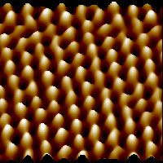
Atoms can now be “seen”
Image of individual atoms in Mica (from www.di.com, Digital Instruments)
see also http://stm2.nrl.navy.mil/how-afm/how-afm.html

Slide 31
Atoms Are Composite Objects
Protons (+ electric charge), p
Electrons (– electric charge), e
Neutrons (no charge), n
Proton and Neutron have about the same mass
Electron is about 2000 times less massive than proton
Electrical Forces produce attraction between electrons and the protons in the nucleus (they are oppositely charged)

Slide 32
What experiments can we do?
In order to study small objects like atoms, we have three basic techniques:
Studying bound states (like the different kinds of atoms, etc.) – first step … information is limited
Studying the decay of one thing into another – radioactivity – second step … a bit more info
Scattering experiments – final step … LOTS more info (but can be complicated to understand!)

Slide 33
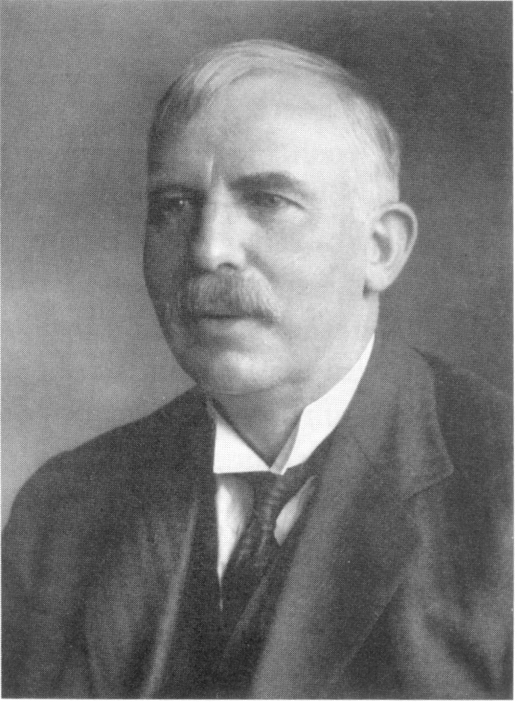
Ernst Rutherford
Nobel prize in 1908 for studying radioactivity
Used radioactivity to produce a beam of “alpha particles”
Used this beam of alpha particles to study other things
Discovered the proton, and postulated the existence of the neutron

Slide 34
Ernst Rutherford
I dated his great-granddaughter!

Slide 35
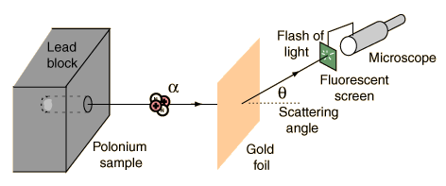
The Geiger – Marsden – Rutherford experiment
Expectation: the high energy alpha particles will see an electric force from the atoms in the gold foil … the model of electric force tells us how they should be scattered … expect lots at small angles, and none at large angles.

Slide 36
What actually happened …
They saw alpha particles being scattered at large angles (a few anyway) … some were even “backscattered” at angles up to 140 degrees.
The only way to explain this is if all the protons in the gold atoms are concentrated at the center of these atoms in a VERY small volume (Recall: F = k*q1*q2/r²)

Slide 37
How can that be?
Again, the protons should REPEL one another …
There must be a NEW force (not gravity or EM) that is much strong (so that it overwhelms the EM repulsion)
We call this the STRONG NUCLEAR FORCE?

Slide 38
Nuclear Strong-force
Hold nucleus together by overcoming the repelling protons in nucleus:
Strength of the nuclear strong-force determines how fast nuclear reactions will proceed
1000 times stronger than EM force!!!
proton
neutron
neutron
proton

Slide 39
The physics of atoms and their nuclei is well understood
The breakthroughs were made in the 1920’s – 1930’s
Quantum Mechanics – discrete energy levels
Relativity – things are different when you’re moving very fast!
Evidence for depth of understanding is all around you
Lasers
Microwave ovens
X-ray imaging
Fluorescent lights
Nuclear power
Quantum Mechanics helps us understand the basic properties of atoms, and explains the grouping in the Periodic Table

Slide 40
Proton Substructure
In the 1950’s, experimenters at SLAC carried out experiments using high energy electrons on protons … hmmm … sounds a bit like Rutherford’s experiments!
In fact, it was EXACTLY the same idea!!!
Expect lots of electrons scattered at small angles, and none (or very few) at large angles …
Much more difficult experiment than Rutherford!

Slide 41
Results
The data looked almost EXACTLY like Rutherford’s data!
The conclusion: The electric charge of the proton must NOT be uniformly distributed, but in fact must be concentrated into several much smaller objects inside the proton
The objects were called QUARKS (by Murray Gell-Mann)

Slide 42
Quarks, Hadrons and all that…
 | Generations
 | I | II | III
Charge = +2/3 | u (up) | c (charm) | t (top)
Charge = -1/3 | d (down) | s (strange) | b (bottom)
Increasing mass
Also, each quark has a corresponding antiquark. The antiquarks have opposite charge to the quarks

Slide 43
Back to Cosmology!

Slide 44
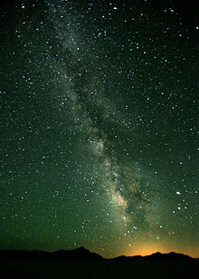
The Milky Way

Slide 45
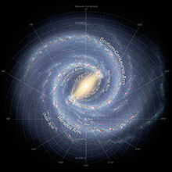
The Milky Way

Slide 46
Dark Matter
How fast is the Milky Way rotating?
We can calculate how fast it SHOULD be rotating, based on the stars that we see … we know many there are and how big they are, so that should define the rotational speed.
PROBLEM: the Milky Way is rotating FAR too quickly!!!
POSSIBLE SOLUTION: there is some new form of matter that we cannot “see”, that interacts gravitationally, but not in any other way (electric charge = color charge = weak charge = 0)
Stuff that interacts gravitationally we call “matter”
But we can’t see it … so we’ll call this new stuff “DARK MATTER”

Slide 47
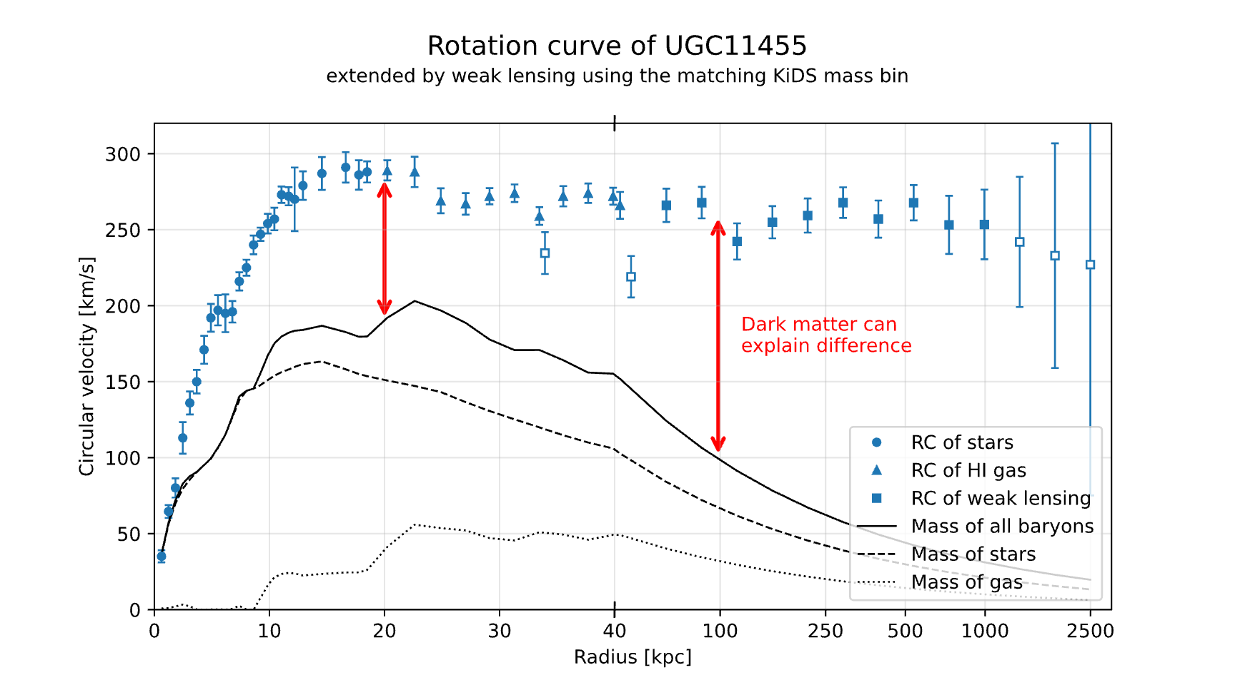

Slide 48
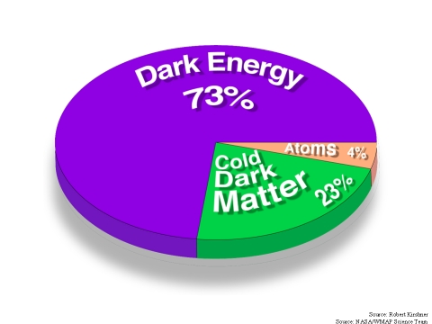
Dark Energy
We postulate that there is some form of energy that we cannot see that is fueling the expansion of the universe – we call it “dark energy”
It is smoothly distributed and invisible
Doesn’t clump together like matter into galaxies

Slide 49
Conclusions
We understand a tremendous amount about the particles and forms of energy that make up our universe.
Our best theory - The Standard Model of Particle Physics - describes an incredible amount of data very well.
Yet, serious questions remain:
What is dark matter?
What is dark energy?
What is the theory of everything? Is string theory right?
The future will be very interesting … but …
We have some work to do understanding some BASIC physics principles (electricity, magnetism, light, atomic and nuclear physics) before we can hope to understand some of the bigger issues … over the next 15 weeks, we’ll do just that!!!

